Slide 1
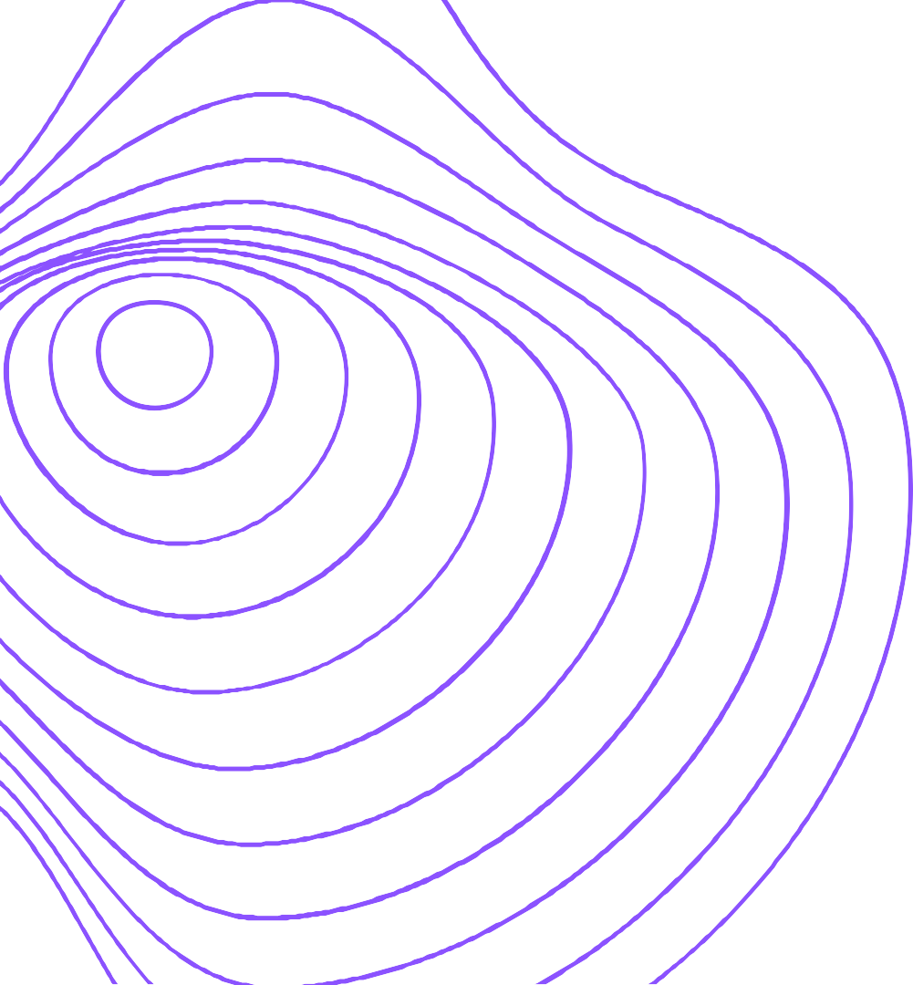

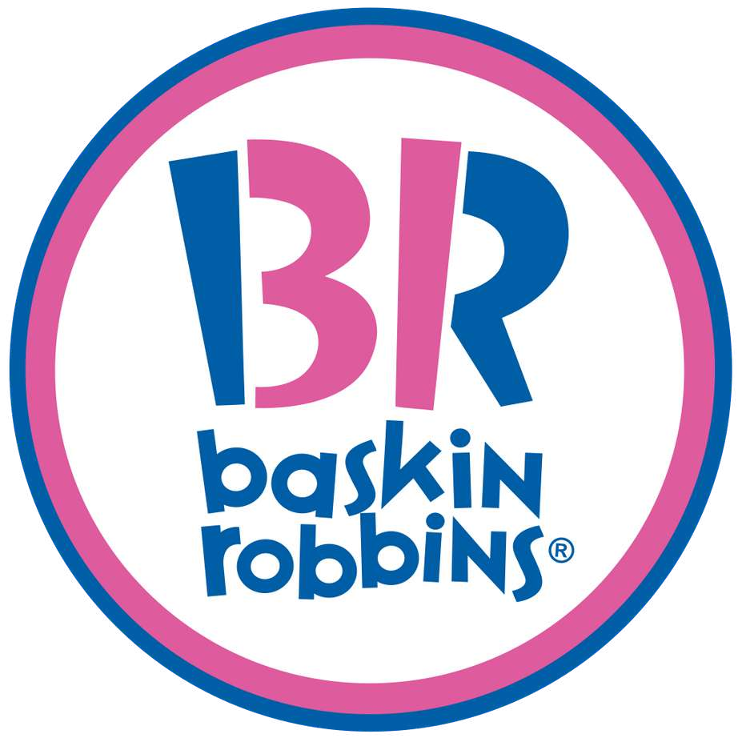


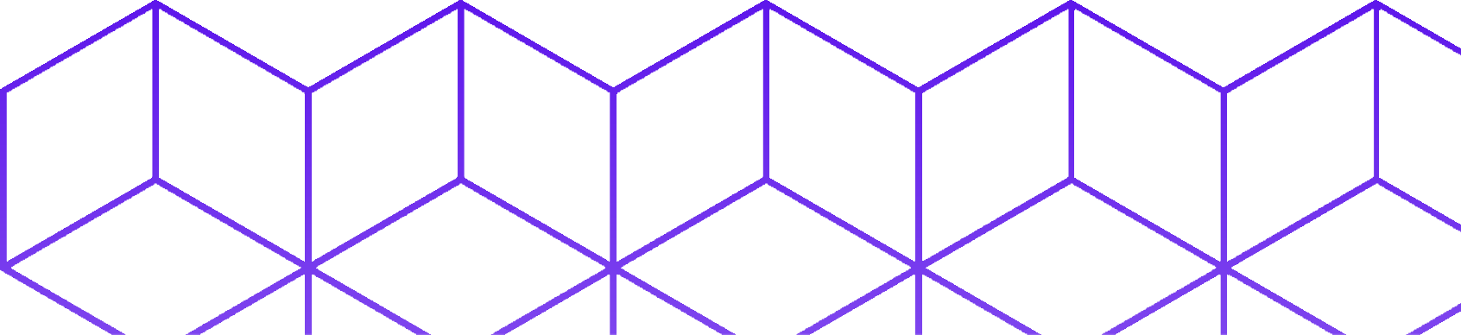
Launching MVP For Baskin Robbins APP and Delivery Feature!
Himanshu Wankhade
E23CSEU0380@bennett.edu.in

Slide 2


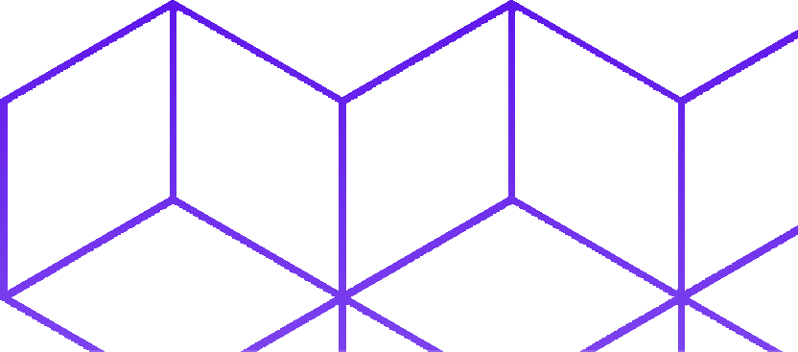
COMPANY OVERVIEW
ABOUT
Baskin Robbins is a well-known ice cream brand worldwide and
especially loved in India. The brand has licensed Graviss Foods Pvt Ltd to operate in India and parts of South Asia, and it has expanded to over 750 exclusive parlors in more than 170 cities, as well as thousands of retail touchpoints in the country.
PROBLEM STATEMENT
The company relies heavily on food delivery apps and
its website for revenue in India, but wants to launch its own app to avoid commissions and gain control over customer experience, ultimately hoping to attract customers away from competitors.
Product Vision
"To become the fastest and safest delivery of people's favorite ice cream"
Product Mission
"To deliver customer orders fast and safely! "
COMPANY VISION
"To become most loved ice cream"

Slide 3


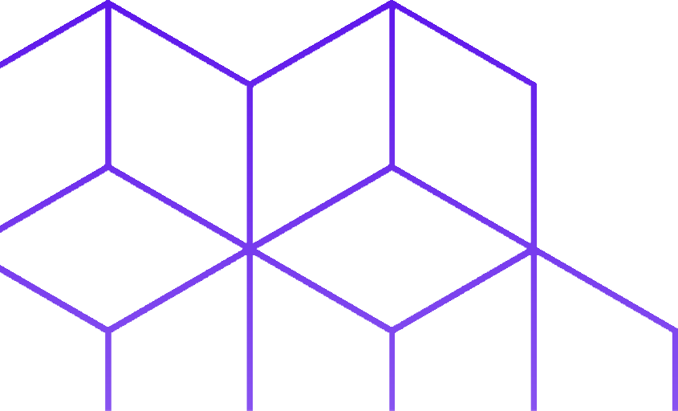
MARKET SIZING FOR ICE CREAM SELLING
Total Addressable Market (TAM)
India Population = 1.408 Bil (source)
Assumption that all of India people spent money to buy ice cream in a month = INR 300. (source)
Total = 1.408 Bil X INR 300 = 4.22 Trillion
Serviceable Available Market (SOM)
India's Population who have smartphones = 43.5% of the population (source)
SAM = INR 4.22 T X 43.5% = INR 1.837 Trillion
TAM
INR 4.22 T
SAM
INR 1.83 T
Serviceable Obtainable Market (SOM)
India Population in Major Cities = 58.838.116 Bil (source) Assumption that all India's population in Major Cities are using smartphone
Percentage of India people who lives in Major Cities: 0.04%
SOM = INR 1.837 Bil X 0.04% = INR 734,8 Mil
SOM
INR 734.8 M

Slide 4


MARKET SIZING FOR ICE CREAM DELIVERY
Total Addressable Market (TAM)
India Population = 1.408 Bil (source)
The assumption is that all Indian people at least buy ice
Serviceable Available Market (SOM)
India's Population who have smartphones = 43.5% of the population (source)
SAM = INR 1.5 T X 43.5% = INR 654.128 Million
cream once a month = INR 89 X 12 = 1,068 INR. (source)
Total = 1.408 Bil X INR 1068 = INR 1.5 Trillion
TAM
INR 1.5 T
SAM
INR 654.128 T
SOM
INR 261.65 M
Serviceable Obtainable Market (SOM)
India Population in Major Cities = 58.838.116 Bil (source)
The assumption is that all of India's population in Major Cities are using a smartphone
Percentage of Indian people who lives in Major Cities: 0.04%
SOM = INR 654.128 X 0.04% = INR 261.65 Mil

Slide 5



Improving Product Growth With Funnel Metrics Analysis Using Pirates Framework
User who click the ads
Users who download the app Users who launch the app
Acquisition
Activation
Users who made their first order and Delivery using Baskin Robbins Mobile App
Retention
Users come back to make an order again
Revenue
We got revenue from every delivery order have been made.
Referral
Goals:
To ensure that our customer use our
delivery service rather than Swiggy or Zomato.

Slide 6
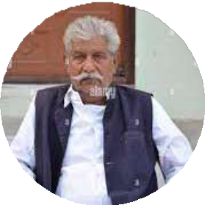
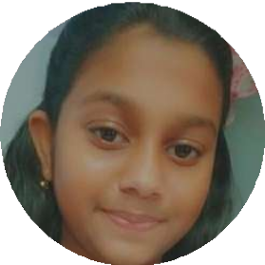
USER PERSONA
Rajendra (69) Government Employee Retirement
He is an old man who loves ice cream so much. He loves ice cream because that's the only food that he could enjoy right now. Baskin Robbins is his favorite
Motivation: He wants to buy ice cream but he is too lazy to buy it from the store.
Goals: To buy ice cream without moving away from his lazy chair.
Pain Points:
Delivery price from Baskin Robbins store that he knows to home is expensive because the distance is far away.
When it arrives at home, the ice cream is already melted. Hard to find the driver when he orders the ice cream.
Aaradhya (15) Hyper Active Students
She is an active child, who dislikes milk so much. The only way to give her milk is via ice cream. Baskin Robbins is her favorite ice cream.
Motivation: She wants to buy ice cream but she doesn't have time to buy it because she is busy with her daily activity.
Goals: To buy the ice cream that she wants and deliver it to her home.
Pain Points:
The ice cream already melted when it arrive at her place.
She doesn't feel the services that she experienced in the store. Delivery service is too slow.

Slide 7

Pain points | Opportunity | "How Might We" Statement
The ice cream already melted when it arrived. | Users need delivery services that provide cooling boxes to ensure that the ice cream is not melted | How might we deliver customer orders fast and safely with more affordable prices and better services?
The delivery service is too slow. | Users need delivery services to make sure they got their ordered ice cream fast (at least arrived 30 minutes after they ordered it)
The delivery price is to expensive. | Users looking to use delivery service with more affordable price
The delivery service is bad. | Users want to have a same quality service that they feels in store

Slide 8
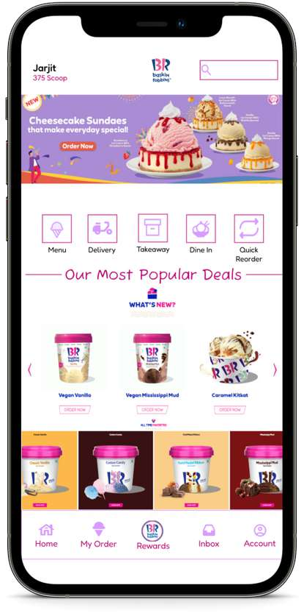
MVP - BASKIN ROBBINS MOBILE APP ONLIEN PURCHASE AND DELIVERY
Objectives
Allow customers to purchase ice cream online wherever they are, and we deliver it to their place.
How it works
We implement MVP type "single-feature", which is on the first release, features that users could access are "menu" and "delivery".
Features
Users can see our menu list
Users can purchase for takeaway or delivery Users can book a table for dining online Users can easily repeat order
Success Metric
Daily Active Users * Number of Orders Average time of delivery Customer Satisfaction
Why choose us?
We keep the quality of our service.
We are cheaper because we don't charge our store
Our driver uses a specific cooler box to make sure your ice cream doesn't melt when it arrives. We deliver your order from the nearest store to your place.
*Definition of Active Users = Users who register and make at least one purchase

Slide 9
USEr FLOw

Slide 10
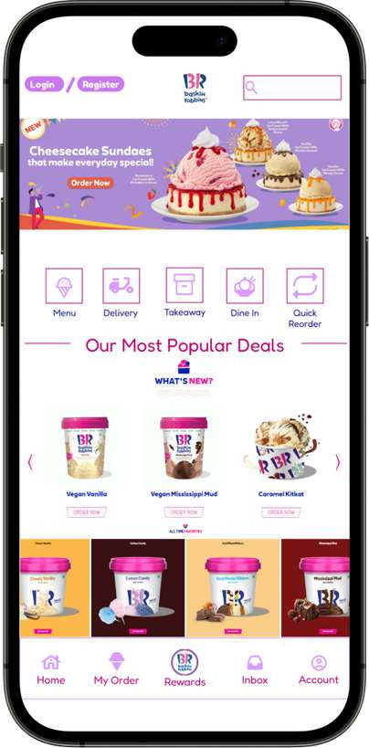
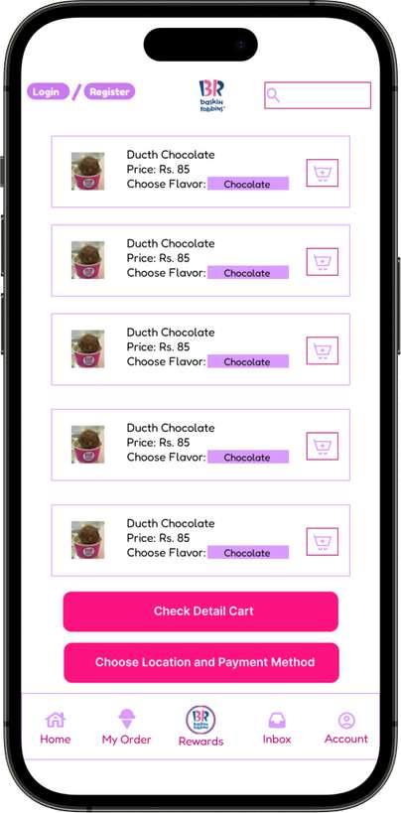
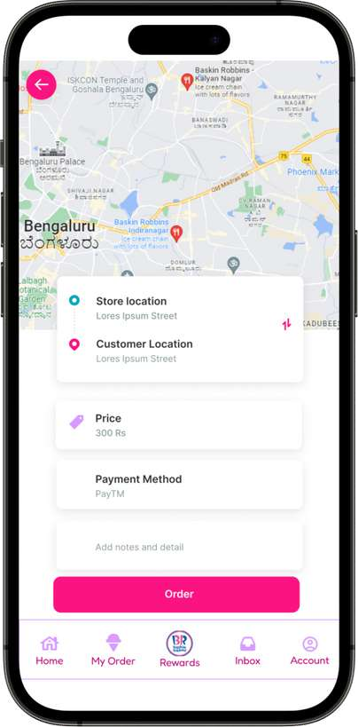
In Hompage, users can see Login/Register CTA, Search Bar, and feature list, including Menu, Delivery, Takeaway, Dine In, and Quick Reorder with Navigation Bar
On the Homepage, users click "Delivery" to use the delivery feature. After they click CTA Delivery, they will be directed to visit the "cart page" to order the ice cream that they want to purchase.
After they click choose location and payment method on the cart page, they'll need to input the location they want to receive the ice cream and what kind of payment method they want to use

Slide 11
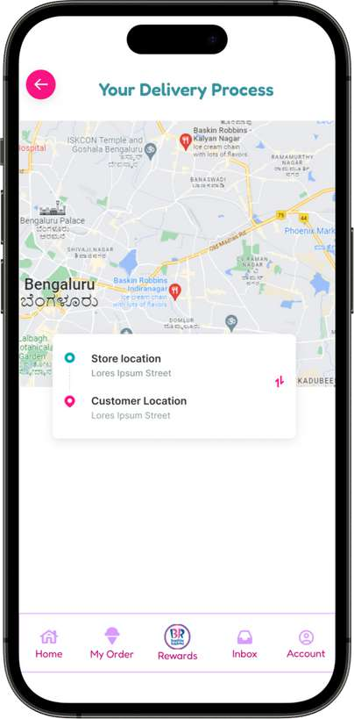
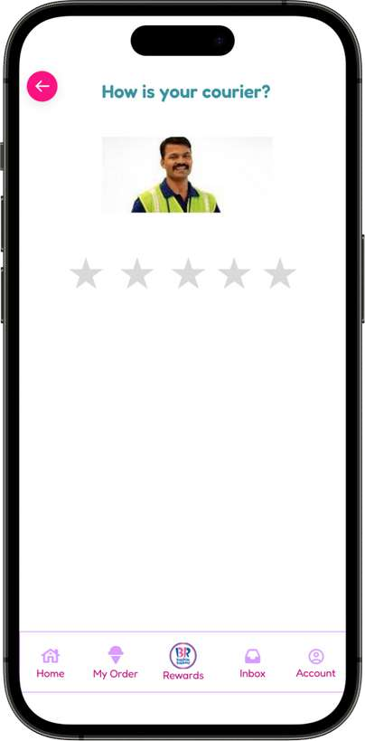
This "Delivery Progress Page" will be shown after users pay the order. This page will show users' delivery progress
This "Driver Rating Page" will be shown after users receive the order. On this page, users need to give rate their delivery services.

Slide 12

GO-TO-MArkET STrATEGy
Positioning
Our delivery services will be positioned to help
Target Market
Distribution
We made it available on Appstore and Playstore
We target our customer who lives in big cities and don't have time to buy ice cream directly from our store.
our main product (ice cream) purchase and deliver to our customers directly with the same quality service as our offline stores and deliver it safely (the ice cream doesn't melt when it arrives).
Promotion
Promoted through banners, and sales in our offline stores.
Promoted through social media, and email marketing to reach a wider audience.
Analysis
Key metrics such as the number of orders, average delivery time, and customer satisfaction will be tracked and measured periodically to make data-driven decisions for upcoming improvement
Monetization
We give delivery prices based on the distance from customers' location to the nearest store.
Product Development
User feedback from surveys and reviews from Playstore and Appstore will continuously be gathered and used to improve Baskin Robbin App over time.

Slide 13
THANK YOU
Himanshu Wankhade
E23CSEU0380@bennett.edu.in

